Slide 1
Computer Organization and Architecture
DIRECT MEMORY ACCESS
DMA I/O
LECTURE NO 10

Slide 2
Direct Memory Access
Interrupt driven and programmed I/O require active CPU intervention
  Transfer rate is limited for fast devices
  CPU is also tied while managing an I/O transfer
DMA is the answer
Notes:
CPU is also tied while managing an I/O transfer because a number of instructions must be executed for each I/O transfer

Slide 3
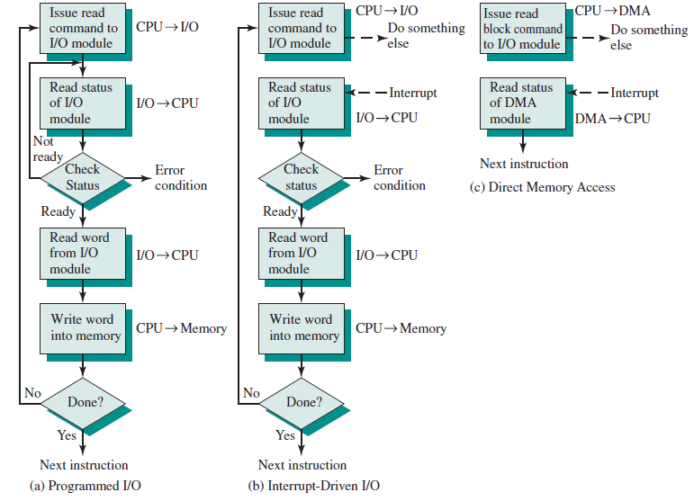
Notes:
Technique for input of a block of data from

Slide 4
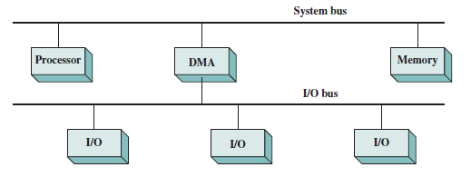
DMA Function
Additional Module (hardware) on bus
DMA controller takes over from CPU for I/O
Notes:
Using simple programmed I/O, the processor is dedicated to the task of I/O and can move data at a rather high rate, at the cost of doing nothing else. Interrupt I/O frees up the processor to some extent at the expense of
the I/O transfer rate. Nevertheless, both methods have an adverse impact on both
processor activity and I/O transfer rate.

Slide 5
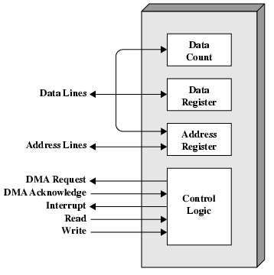
DMA Module Diagram
Notes:
DMA request line high when bus is requested

Slide 6
DMA Operation
CPU tells DMA controller:-
  Read/Write
  Device address
  Starting address of memory block for data
  Amount of data to be transferred
CPU carries on with other work
DMA controller deals with transfer
DMA controller sends interrupt when finished
Notes:
Whether a read or write is requested, using the read or write control line
between the processor and the DMA module
• The address of the I/O device involved, communicated on the data lines
The starting location in memory to read from or write to, communicated on
the data lines and stored by the DMA module in its address register
• The number of words to be read or written, again communicated via the data
lines and stored in the data count register

Slide 7
Direct Memory Access
I/O module shares the bus with the processor
It can use the bus only when the CPU does not need it
Or it can steal cycles from the CPU by forcing it to free the bus
Procedure:
  Processor sends message to DMA (R/W, where, how much)
  Processor continues while I/O proceeds
  At the end, I/O module sends interrupt signal to the processor

Slide 8
DMA Transfer
Cycle Stealing
DMA controller takes over bus for a cycle
Transfer of one word of data
Not an interrupt
  CPU does not switch context
CPU suspended just before it accesses bus
  i.e. before an operand or data fetch or a data write
Slows down CPU but not as much as CPU doing transfer
Notes:
It needs to do this to transfer data to and from memory over the system bus. For this purpose, the DMA module must use the bus only when the processor does not need it, or it must force the processor
to suspend operation temporarily. The latter technique is more common and is
referred to as cycle stealing, because the DMA module in effect steals a bus cycle.

Slide 9
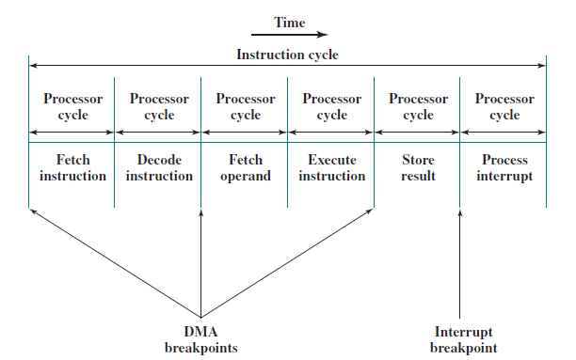
DMA breakpoint vs Interrupt breakpoints

Slide 10
Differs from an interrupt
DMA can interrupt the processor in the middle of an instruction (before fetch, after decoding, after execution)
It does not interfere with the running program
The CPU is idled (waiting for access to the bus)
The system is just becoming slower

Slide 11
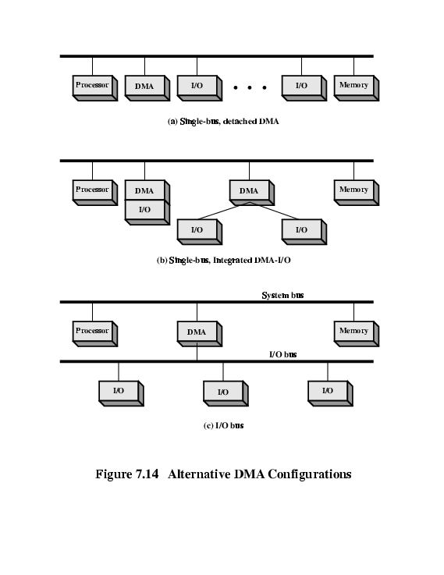
DMA Configurations (1)
Single Bus, Detached DMA controller
Each transfer uses bus twice
  I/O to DMA then DMA to memory
CPU is suspended twice
Notes:
In the first example, all modules share the same system
bus. The DMA module, acting as a surrogate processor, uses programmed I/O to
exchange data between memory and an I/O module through the DMA module. This
configuration, while it may be inexpensive, is clearly inefficient. As with processor controlled
programmed I/O, each transfer of a word consumes two bus cycles

Slide 12
DMA Configurations (2)
Single Bus, Integrated DMA controller
Controller may support >1 device
Each transfer uses bus once
  DMA to memory
CPU is suspended once

Slide 13
DMA Configurations (3)
Separate I/O Bus
Bus supports all DMA enabled devices
Each transfer uses bus once
  DMA to memory
CPU is suspended once
Notes:
This reduces the number of I/O interfaces in the DMA module to one
and provides for an easily expandable configuration.

Slide 14
I/O Channels
I/O devices getting more sophisticated
e.g. 3D graphics cards
CPU instructs I/O controller to do transfer
I/O controller does entire transfer
Improves speed
  Takes load off CPU
  Dedicated processor is faster
Notes:
The I/O channel represents an extension of the DMA concept. An I/O
channel has the ability to execute I/O instructions, which gives it complete control
over I/O operations.

Slide 15
Input-Output Processor
Input-Output Processor (IOP)
  Classified as a processor with direct memory access capability.
  IOP fetches and execute its own instructions
    Independent of the CPU
    CPU initiating the IOP program
  CPU is the master processor. IOP is considered the slave processors
  There can be more than one or more IOP’s

